Slide 2
Request for Proposals
Title III B
Title III C
Title III D
Ombudsman Initiative
Ombudsman (Title VII)

Slide 3
Timeline
RFP Made Available - 3/30/2016
Bidder’s Conference - 4/13/2016
Proposals Due - 5/13/2016
Proposals Reviewed - 5/16/2016 – 5/20/2016
Board of Director Review - 5/23/2016
Notification - 5/27/2016
Appeals Deadline - 6/10/2016
Contract Negotiation - 6/20/2016 – 6/24/2016
Services Begin - 7/1/2016

Slide 4
General Requirements
Availability – Open to all BUT targeted
Location
  Service location in Santa Clara County
  East San Jose (Case Management) and Mountain View (Case Management)
  Minimum Match – Required for Title IIIB and Title IIIC funding
  Goals – 6 areas
    Target Population
    Staffing & Volunteers
    Coordination
    Public Information
    Client Input
    Client Contribution

Slide 5
General Requirements, con’t.
    Reporting – Ability, 60+ only
      Greatest social need
      Low-income minority
      Geographically isolated individuals

Slide 6
Program Standards

Slide 7
Program Standards
Refer to the Program Standards attachment. Apply for:
  Adult Day Care
  Case Management
  Legal Assistance
  Transportation
  Congregate Meals
  Home Delivered Meals
  Disease Prevention & Health Promotion
  Elder Abuse Prevention
  Ombudsman Initiative
  Ombudsman (Title VII)

Slide 8
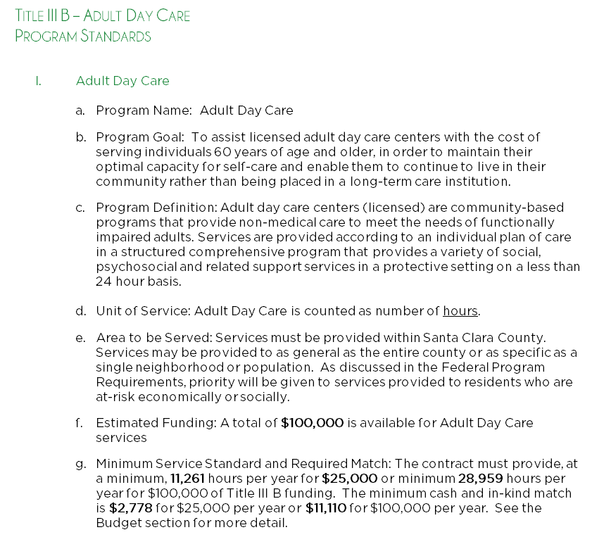
Program Standards, con’t.

Slide 9
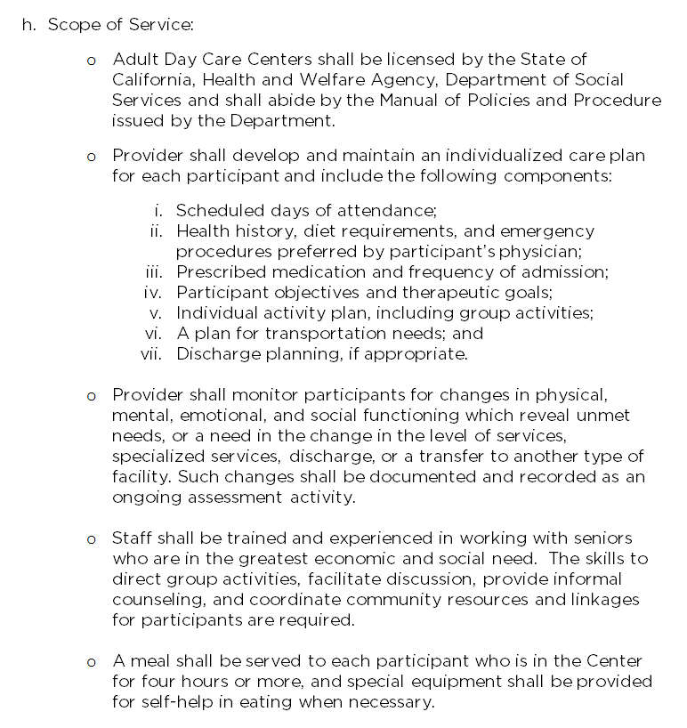
Program Standards, con’t.

Slide 10
Application Instructions

Slide 11
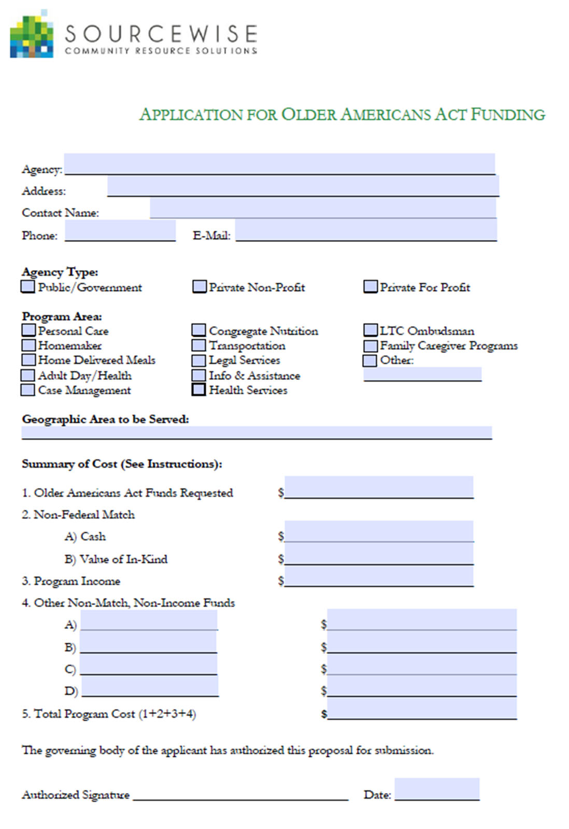
Application Cover Page

Slide 12
Program Description

Slide 13
Program Description
Adequacy of plan and methodology to provide proposed services within required program specifications.
Comparison of program objectives and units of service to those specified in the RFP.
Capability of proposed timetable and process of achieving objectives.
Minority persons in greatest economic need proportionate to the total elderly population served.
Adequacy of plan for client contributions.
Adequacy of plan for recruitment and use of volunteer and staff resources.
Capability of agency process to work with and encourage client input in planning and program evaluation.

Slide 14
Program Description, con’t.
Demonstration of appropriate agency linkage and coordination, including subcontracts or agreements with other community organizations and resources to increase cost effectiveness and reduce duplication.
Adequacy of plan for expansion of existing service delivery.
4 pages maximum
Goals and Objectives
  Specific!
  Measurable!
  Attainable!

Slide 15
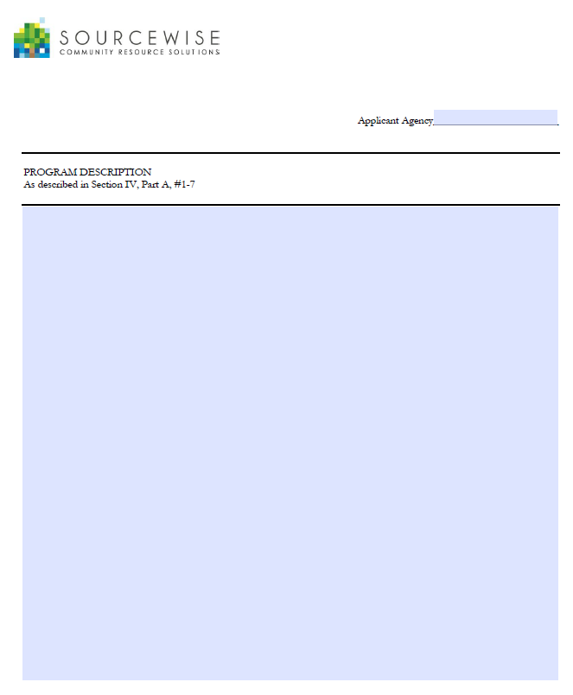
Program Description, con’t.

Slide 16
Program Description, con’t.
Targeting
  Service provider must have established methods, other than use of means of test, to provide services to all persons aged 60 and over
  Service provider must show intent and methodology to serve the needs of:
    Age 75+
    Low Income (<Federal Poverty)
    Minority
    Living Alone
    Demonstrate serving the target population (at-risk socially/economically), keeping in-line with the intent of the Older Americans Act.
    Goals include “will serve 80% Hispanic clients”, “will provide service to 50 low-income seniors”

Slide 17
Program Description, con’t.
Staffing & Volunteers
  Demonstrate recruitment and training of staff & volunteers to support the program.
  Provide appropriate staff to perform the service.
  Goals include:
    Hire/Retain a full-time case manager with a MA in Social Work.
    Recruit 20 volunteers to perform In-Take process.

Slide 18
Program Description, con’t.
Coordination
  Form and administer cooperative agreements with other agencies to ensure comprehensive service delivery and avoid unnecessary duplication.
  Effective coordination with other community programs and avoid duplication of services.
  Goals include discussion of MOUs with other agencies, linkage of clients to other agencies.

Slide 19
Program Description, con’t.
Public Information/Outreach
  Provider must have planned information and outreach activities, including distribution of printed materials advertising the program.
  Effectively promote the program to the community – communicate availability to all.
  Goals include:
    “Will distribute 200 program brochures”
    “Will perform 10 community outreach events”

Slide 20
Program Description, con’t.
Client Contribution
  Provider must provide clients with the opportunity to voluntarily contribute to the cost of the program.
  Show that opportunity exists.
  Goals include:
    “Distribute letter upon intake describing voluntary contribution opportunity”
    “Conduct annual client contribution drive”

Slide 21
Program Management

Slide 22
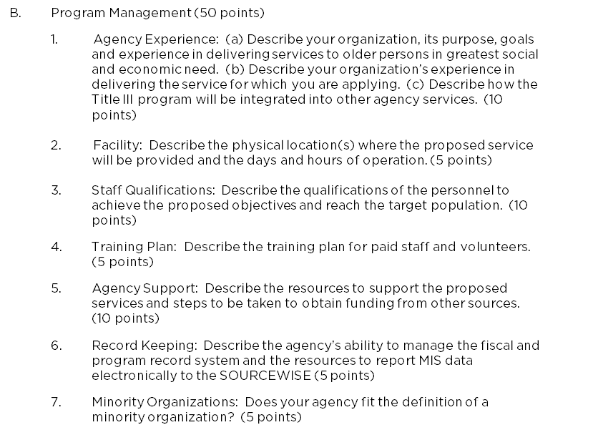
Program Management

Slide 23
Budget

Slide 24
Budget
General Tips:
Work with Fiscal
Only show expenses for THIS PROGRAM
  No other agency expenses
  No other program expenses
  Meet the 11.11% match for Title IIIB and Title IIIC funding
  Understand funding categories
  No Red! Review for accuracy.

Slide 25
Budget, con’t.
OLDER AMERICANS ACT FUNDING
  Sourcewise funds which you are applying.
  If applying for $100,000 of Adult Day Care, must add up to $100,000 on the cover sheet (funds must balance)

Slide 26
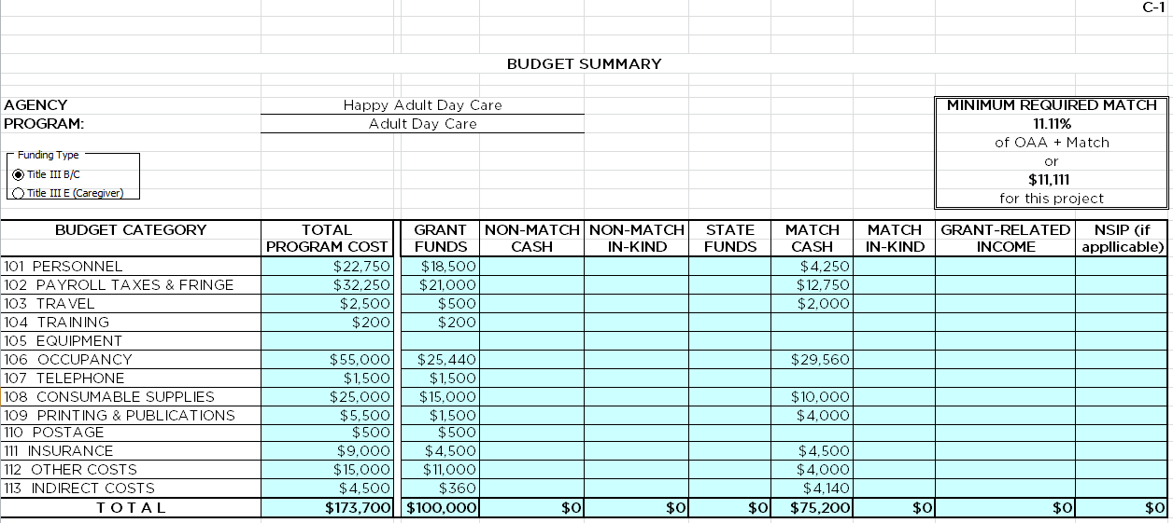
Budget, con’t.

Slide 27
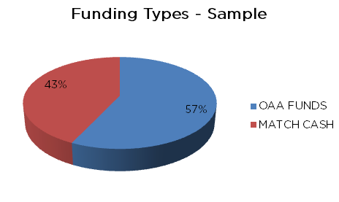
Budget, con’t.

Slide 28
Budget, con’t.
MATCH (Cash and In-Kind)
Cash – most other non-federal, non-income funding (city, county, tate, private foundation, United Way, etc.)
In-Kind – fair market value of volunteer time, donated goods/space/etc.
Usually ~25-80% of total program cost, at least 11.11% Match for Title IIIB and Title IIIC funding
See RFP for more examples.

Slide 29
Budget, con’t.
Program Income
  Client contributions related to provision of the service: client contributions, donations received in the name of the program, fundraising in the name of the program.
  Program income received as a direct result of the program must be used for costs directly related to that program. Funds shall be spent before Sourcewise funds are applied, and cannot be used to meet the local match requirement.
  Usually ~5-10% of the total program cost, but can be more depending on the type of service.

Slide 30
Budget, con’t.
Other Resources
Funding other than OAA, Match, or Program Income
Usually just other Federal income (non-HNVF)
Usually 0% of total program cost!

Slide 31
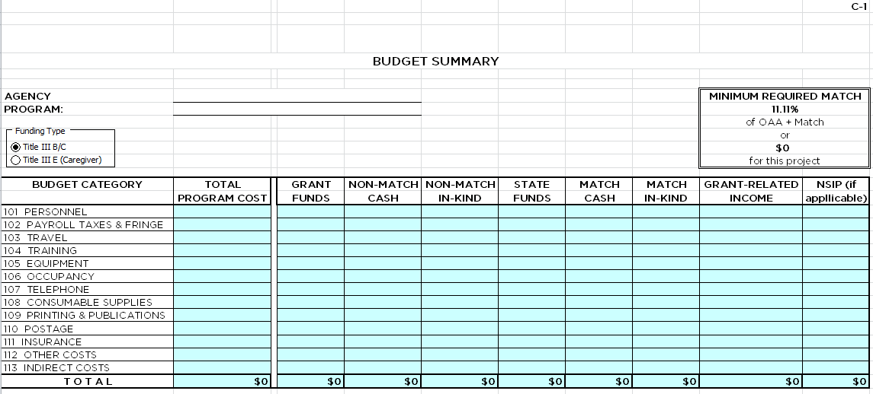
Budget, con’t.

Slide 32
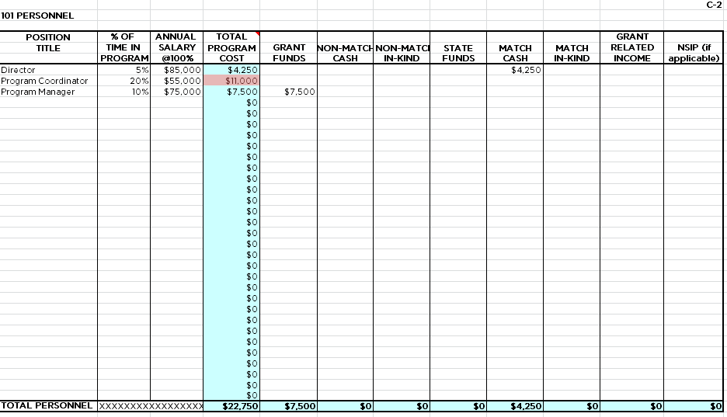
Budget, con’t.

Slide 33
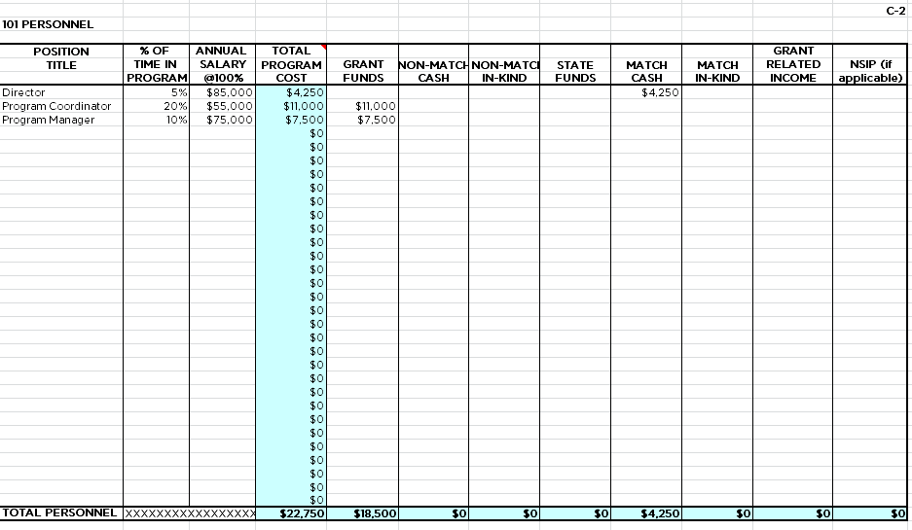
Budget, con’t.

Slide 34
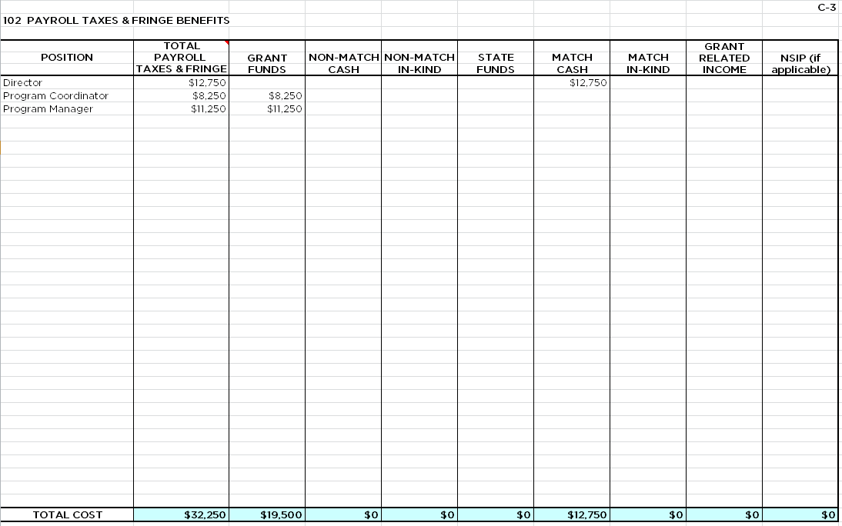
Budget, con’t

Slide 35
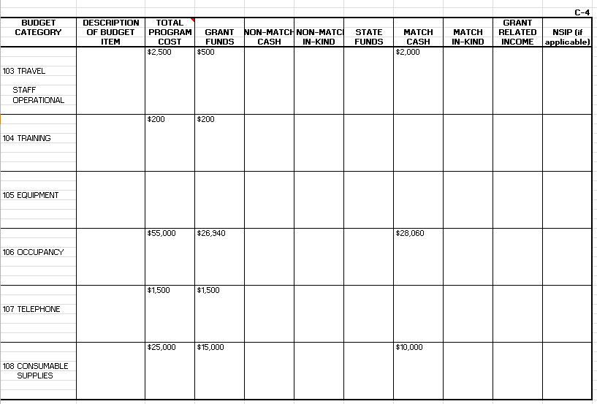
Budget, con’t.
C4 – Assorted I

Slide 36
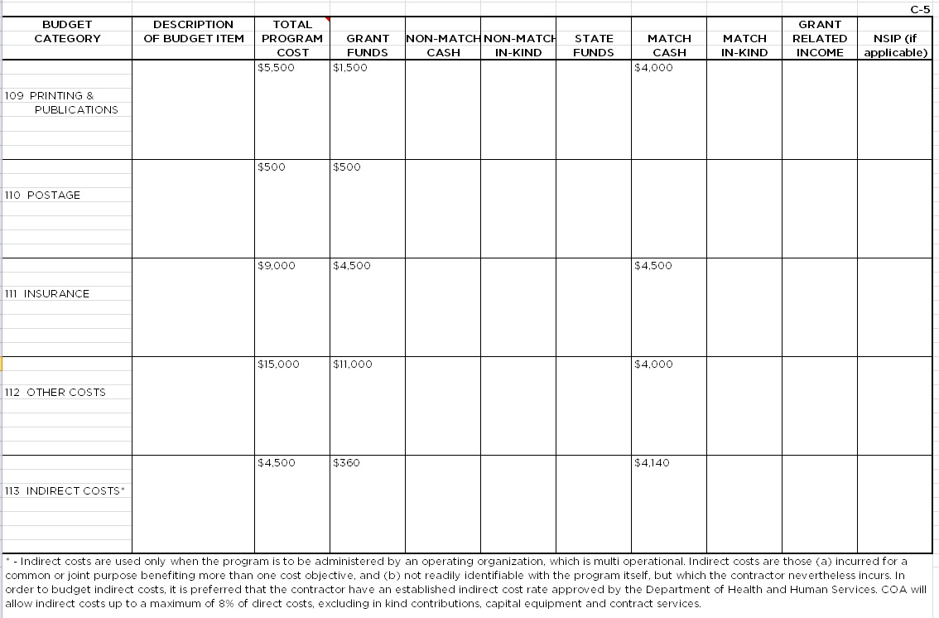
Budget, con’t.
C4 – Assorted II

Slide 37
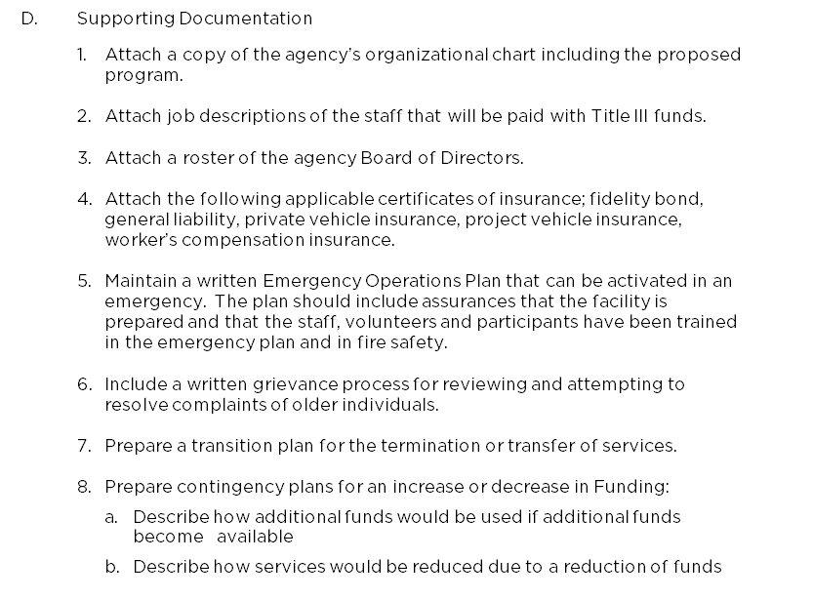
Supporting Documentation

Slide 38
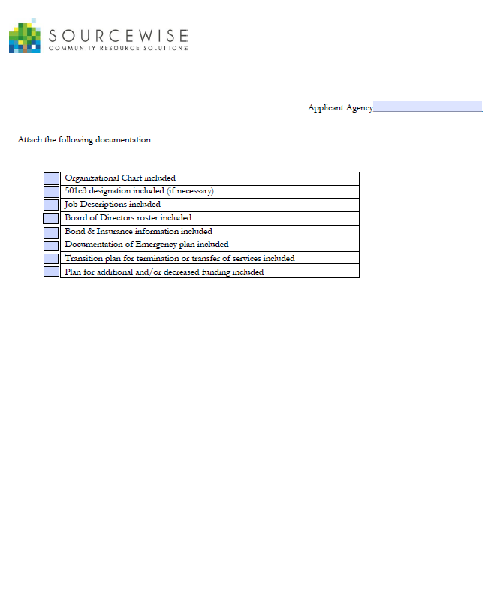
Supporting Documentation, con’t.

Slide 39
Scorecard
Program Description = 54 points
Program Management = 20 points
Budget = 18 points
Supporting Documentation = 8 points
Total points = 100
Scores are used as a basis of evaluation for the review panel, but, the final recommendations of the review panel may differ based on funding availability, quantity and quality of other applications, etc.

Slide 40
Application Packets
RFP packets and program budget workbook can be downloaded at www.mysourcewise.com/area-plan
For RFP information or technical assistance, contact Judy Nguyen, jnguyen@mysourcewise.com
For general information on Sourcewise, contact Information & Awareness at www.mysourcewise.com/contact or call (408) 350-3200, option 1.

Slide 41

Thank you

